Slide 1

Obsidian: what it is, and how to use it
Alex Popescu
Gotanda Lab
Brock University

Slide 2

What is Obsidian?
At its core, it is a simple text editor with some very powerful features
Take notes
Plan days
Set up tasks
*Make connections!*

Slide 3
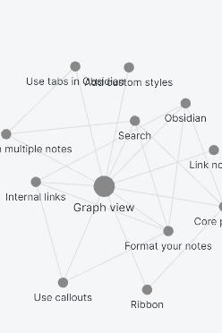
Make connections?
Yes! Make connections between notes!
Making connections between notes is easy, as we’ll see
Helps you see connections that are not immediately apparent.
Let’s look at a bigger example:

Slide 4
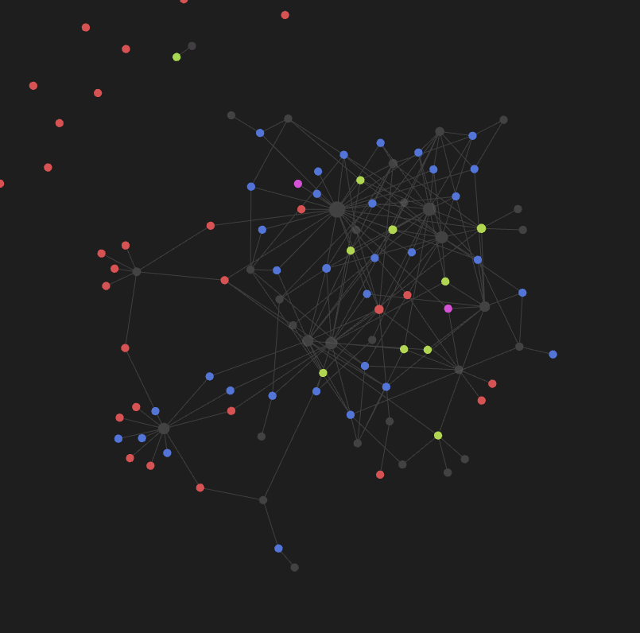
Notes for articles
81 Articles annotated
Connections bring concepts together:
- Link between concepts reinforced or made apparent.

Slide 5
So how do we start?
Start by downloading Obsidian onto your computer or phone and open it.
When asked, create a new vault
- This will create a folder where you choose
- All of your notes will be in this folder!
- You **CAN** make the folder in dropbox, google drive, GitHub, etc (with some work)

Slide 6
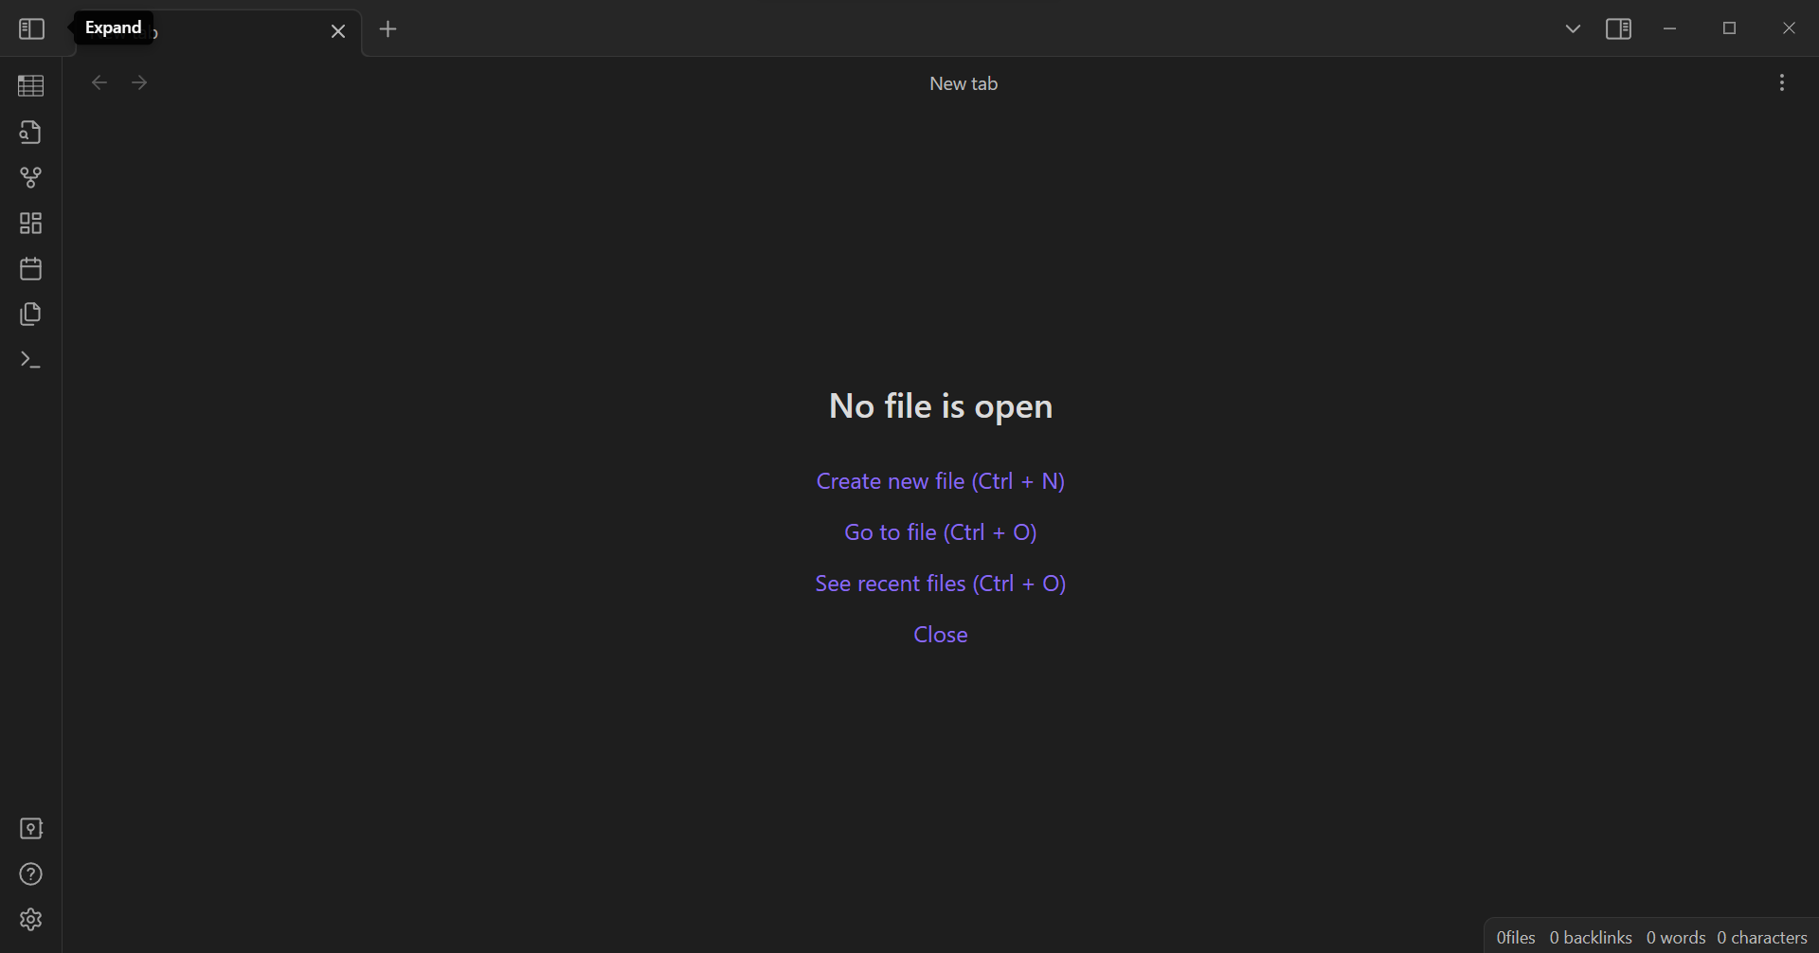
A new beginning
Let’s get familiar with the UI

Slide 7
Notes & Note Explorer
Back/Outgoing links & other cool things
Plugins
Quick Switcher
Graph View
Settings and Vaults

Slide 8
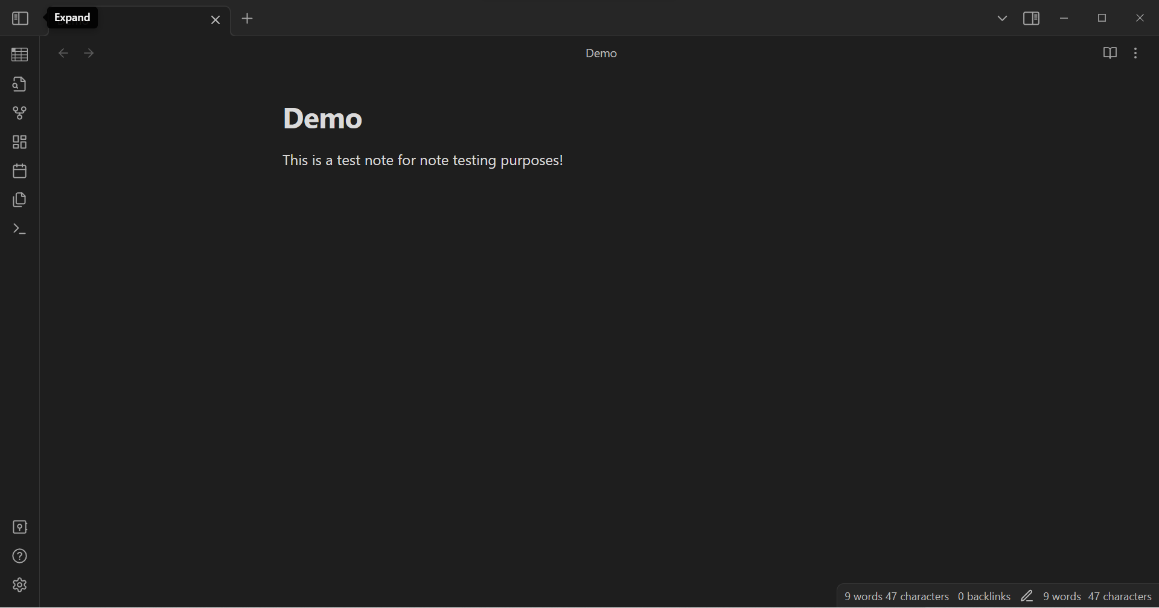
Let’s make our first note!
Either click on “Create new file” or use Ctrl+N
Give your new note a name (e.g. Demo)
You can already start writing, but we first have to talk about formatting.

Slide 9
Lovely lovely markdown
#ThisIsATag
# This is a heading
## A smaller heading
### And so forth
*Italics*
**Bold**
~~Strikethrough~~
==Highlight==
- Lists items
1. Also lists items
[ ] Tasks or checklist
| This makes Tables
^[This is a footnote]
``` This is a code block ```
~~~ So is this ~~~
___ This draws a horizontal line
>This nests text

Slide 10
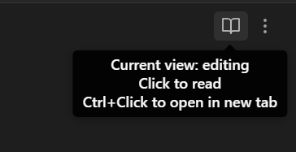
Sometimes, things don’t show up
But that’s ok! You’re still in the editing view. Change it by clicking on the open book in the top right corner.

Slide 11
5 minutes of fun
Write things in the note you’ve created. It can be whatever you want.
Make a shopping list
List of tasks to do today
Start writing your autobiography

Slide 12
Creating links
We’re not done yet… We need to make links.
To do this, you can use [[ ]] to create a link between this one and another.
* You do not need to have the note already created *
Let’s make a link to a note called “Link”.

Slide 13
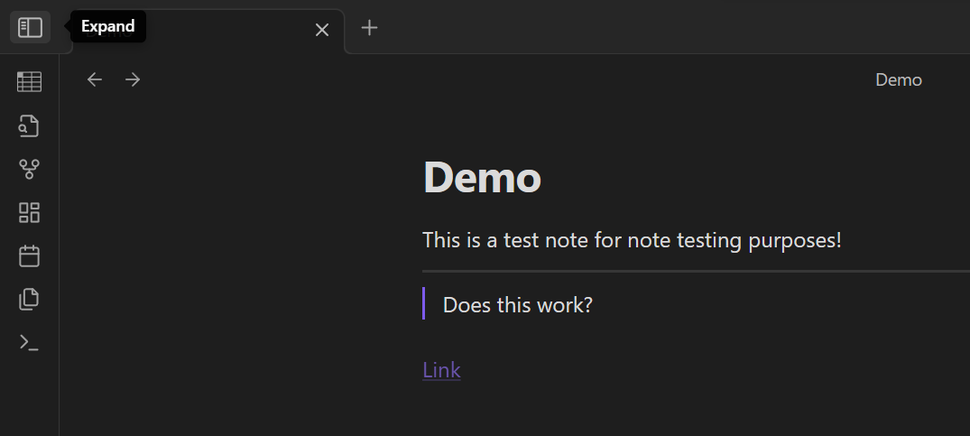
Link
Congratulations! You’ve made your first link!
Open the file explorer by clicking in the top left corner (“Expand”). Does “Link” appear?

Slide 14
The Missing Link
It’s normal if the note doesn’t appear. You haven’t truly created it yet.
Now, click on “Link” in your Demo note. It should open the “Link” note.
Write something in that note
(e.g. Link is the main character in the Legend of Zelda games, not Zelda herself (a common misconception).)
and then go back to the Demo note

Slide 15
Embedding our Link note
Sometimes, you want to embed a note directly into another note.
Let’s embed the “Link” note into the “Demo” note using ![[Link]]
This will stay updated in the eventuality that you change things in the “Link” note. Try it out!

Slide 16
What if I’m a “visual” person?
Great question! Glad you asked.
We don’t have too many notes and connections yet. Let’s fix that.
Take another 5 minutes to get familiar with making new notes, linking them, and embedding them.

Slide 17
Graph View
Now, open the graph view from the left taskbar.

Slide 18
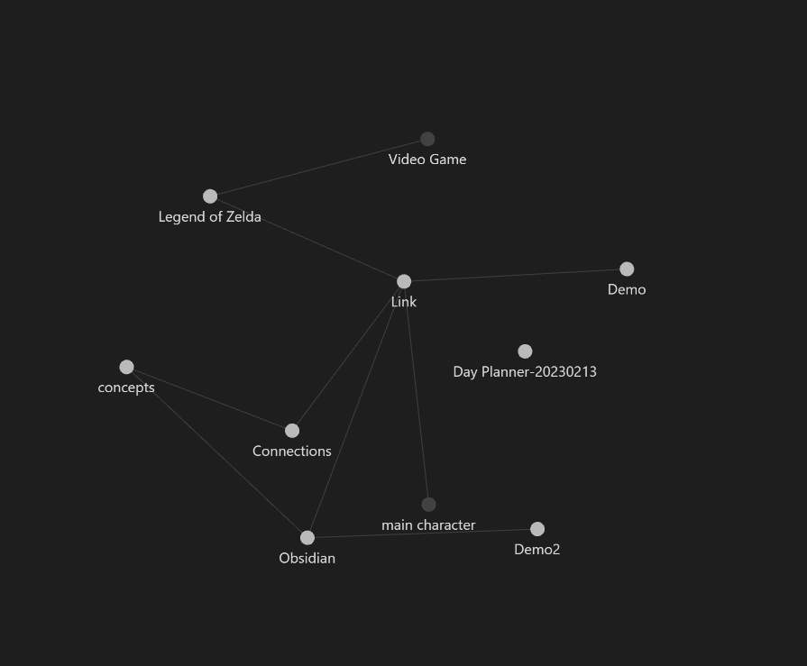
Houston, we have links!
You should now be able to see links between your notes.
Sometimes, I’m forgetful and don’t put links in…

Slide 19
Back links and unlinked mentions
Again, Obsidian is a great “second brain” and will gladly help you make links.
Go to a note and click on the top right icon to expand the linked and unlinked mentions (Back links).
You should see:
- The link(s) that lead to this note
- The notes that mention the name of this note

Slide 20
What about community plugins?
Community plugins make Obsidian very (very) powerful.
Let’s do that together since it’s a bit more involved.
We’re going to plan our day together.

